Slide 2
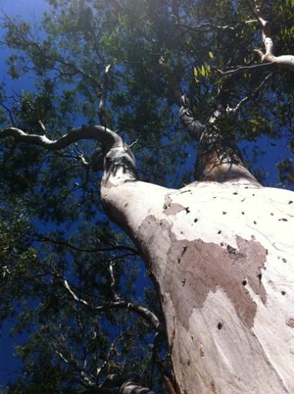
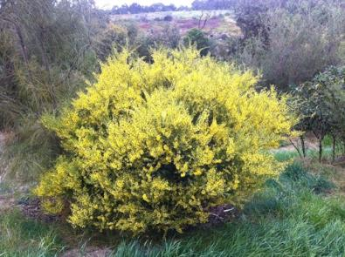
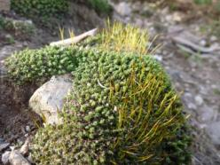
Next time you are outside, have a look around. There are lots of different types of plants around….
…some are tall
…and some are small.
…some are bushy
Notes:
Image 1: River Red Gum
Image 2: Gold Dust Wattle
Image 3: Moss

Slide 3
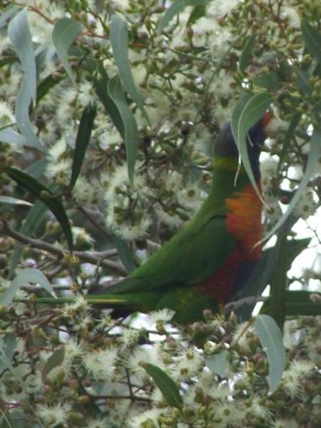
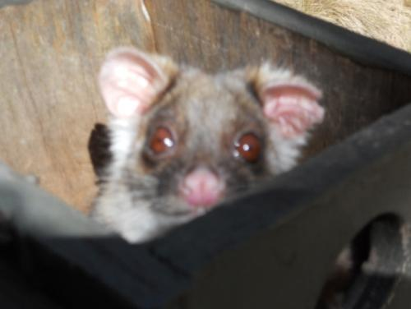
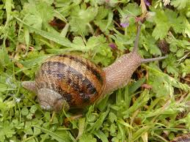
There are also lots of different types of animals around….
…some are noisy
…some are cute
…and some are slimy.
Notes:
Image 1: Rainbow Lorikeet
Image 2: Common Ringtail Possum – this was found in one of the Habitat Boxes in Organ Pipes National Park. The box was designed for Sugar Gliders, but this Ringtail had moved in
Image 3: Common Garden Snail

Slide 4
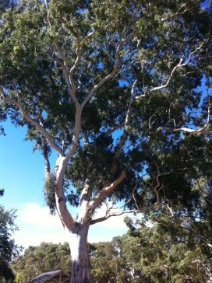
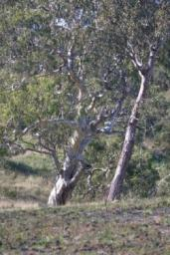
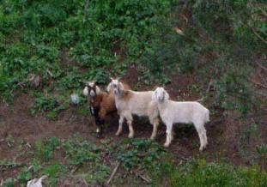
Some of the plants and animals, although the same type, look a little different. Some of this is because of where they live and what has happened to them, but some of it is in their genes. Just like some of us have brown hair, and some have blond.
These River Red Gums are different shapes.
These goats have different coloured coats.
(These goats were running wild
on the Maribyrnong River
and causing lots of damage)
Notes:
You may want to expand on the idea of about genes, or simply say ‘born that way’
Explain that goats are not native animals. This may be a good point to introduce the idea of native, indigenous and exotic species. The concept of feral animals may also be introduced to older students.

Slide 5
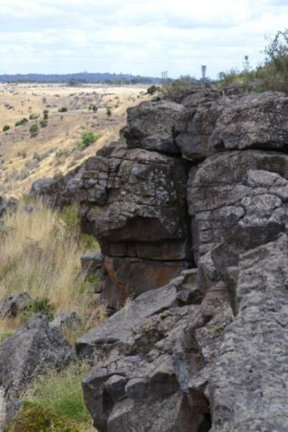
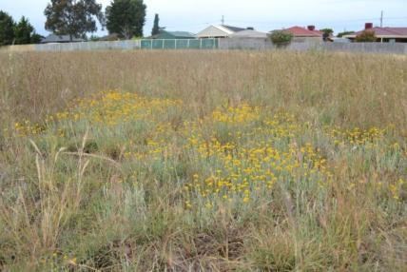
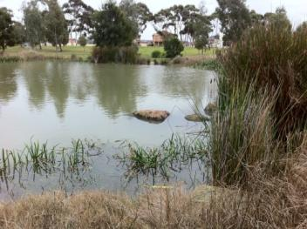
Some areas around you will be….
…steep and dry
…flat and treeless
…wet and watery
Notes:
Image 1: Escarpment at Sydenham Park off the Calder Freeway next door to Organ Pipes National Park. The escarpment leads down to Jacksons Creek which joins up with Deep Creek in this valley to form the Maribyrnong River.
Image 2: Wetland in Cairnlea
Image 3: Isabella Williams Grassland Reserve in St Albans.

Slide 6
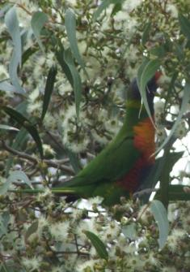
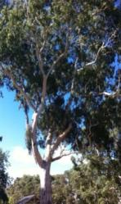
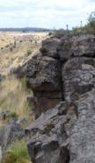
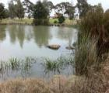
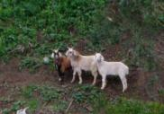
Snails eat plants, birds eat snails, birds live in trees, trees need water, sun and soil.
We are surrounded by Biodiversity Actually - we are part of Biodiversity
Different types of plants and animals Differences within
types of plants and animals
Different types of landscapes
Notes:
Biodiversity - the variety of life on Earth and the natural patterns it forms
Bio = Life, Diversity = Difference
Biodiversity has three parts: Species Diversity - the variety of different species e.g. Golden sun-moth, Eastern Grey Kangaroo, Kookaburra. Genetic Diversity - the variety within each species e.g. One Tiger snake might have distinct stripes, another may look brown. Ecosystem Diversity - the variety of different ecosystems e.g. Plains Grassland, and Escarpment Shrubland.
It is important here to point out that Biodiversity is not just different living things, and different landscapes, but also the interaction between these things- including non-living elements like sun, soil and climate.
It is also important to note here that we are also animals, we form part of the ecosystem.

Slide 7
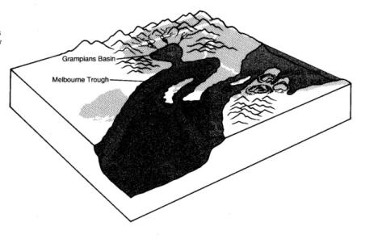
How was our local environment formed?
500 - 400 Million years ago Melbourne was under the ocean. Water from large mountains to the east and the west travelled down rivers into this ocean bringing with it mud and soil. This soil settled at the bottom of the ocean.
400 - 300 Million years ago underground forces caused the earth to buckle and bend. The ground beneath the ocean began to rise, and the water drained off. The mud and soil at the bottom became dry and hardened into sandstone and siltstone.
Notes:
During this time soft bodied animals lived in the ocean, but the only multi-celled organisms on land was algae.
To explore time periods further see Melbourne Museums “600 million years – Victoria evolves http://museumvictoria.com.au/melbournemuseum/discoverycentre/600-million-years/

Slide 8
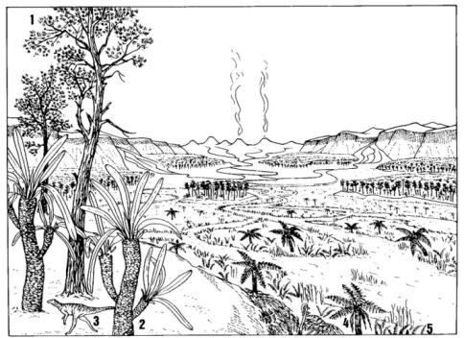
How was our local environment formed?
5-1 Million years ago Volcanoes erupted in the north and west of Melbourne, spewing out runny lava.
The lava filled the valleys creating a wide almost flat plain of a type of lava called ‘basalt’ This cooled and hardened into rock, called ‘basalt rock’. Bluestone is a type of basalt rock.
Old volcanoes can still be seen and visited, can you name some?
Notes:
Lava: molten rock from volcanoes
Volcanoes around Melbourne: In the west Mt Warrenheip, Mt Derrimut and the Organ Pipes, and to the north is Mt Macedon, Hanging Rock and Mt Cooper.
Although many are not technically considered extinct. These volcanoes are not likely to erupt! They have been quiet for a very long time. Mt Derrimut near Sunbury last erupted about 3 million years ago.
Megafauna was around from 2.6 million years ago

Slide 9
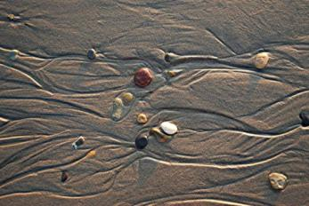
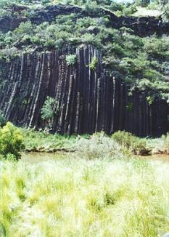
How was our local environment formed?
Only 1 million years ago!
The weather and rain broke up the basalt lava (creating soil), and streams started to form. These streams cut into the ground and formed valleys. Some valleys were shallower like the Kororoit Creek and others were deeper like the Maribyrnong River.
Some areas of the basalt rock are harder than others, that is why you sometimes see escarpments or mini cliffs along the creeks.
Water makes channels in basalt lava (it takes millions of years) just like the ocean makes mini channels on the beach.
Notes:
Image 1: Water causing runnels in sand.
Image 2: The Organ Pipes at Organ Pipes National Park. This is an example of where the rock was harder and did not erode away.
The erosion of the basalt lava can be likened to when you see runnels in the sand at the ocean. You could show the students how water moves sand and soil by tilting a tray of sand and pouring a bucket of water over it.
Humans arrived 50 000 – 60 000 years ago.

Slide 10
How was our local environment formed?
All this activity created different landscapes around Maribyrnong:
Flat Plains – usually with hardly any trees, but lots of grasses and wildflowers
Steep slopes called ‘escarpments’ - with grass and sometimes trees and shrubs
Rivers and Wetlands – with water, trees, and reeds
A different set of plants and animals live in each of these landscapes. These plants and animals, the landscape and the weather together form an “Ecosystem”.
Notes:
The ‘activity’ being the buckling and folding of the land, volcanoes, weather and river formation.
Reeds: Grass-like plants of wet places

Slide 11
What is an ecosystem?
All living and non-living things in a particular area and their interactions. This includes plants, animals, weather and soil type.
Australia is made of hundreds of general ecosystems. In each general ecosystem there are many more smaller, specific ecosystems.
The general broad ecosystems found in Maribyrnong
Grassland ecosystems
Escarpment shrublands
Riparian (River) flats

Slide 12
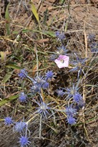
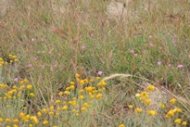
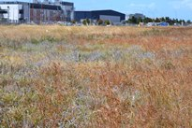
Ecosystem - Grasslands
We have very special grasslands in Maribyrnong. They are called Grasslands of the Victorian Volcanic Plain.
Before European Settlement these grasslands covered much of Victoria – now there is less than 5% left!
They are considered Critically Endangered which means they are in danger of extinction.
Notes:
Legal Status The Native Grasslands of Victoria’s Volcanic Plain are listed as Critically Endangered under the Australian Government Environment Protection and Biodiversity Conservation Act 1999 (EPBC Act). This means they are legally protected.
Image 1: Isabella Williams Grassland Reserve in St Albans
Image 2: Blue Devil and Pink Bindweed at Paramount Grassland in Derrimut
Image 3: Paramount Grassland in Derrimut

Slide 13
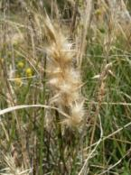
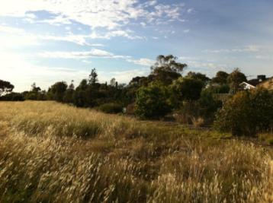
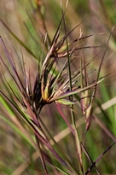
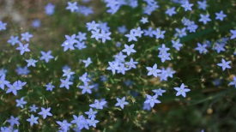
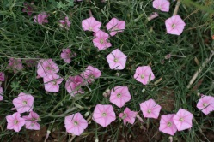
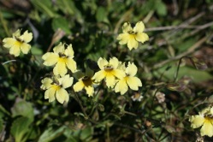
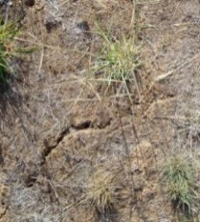
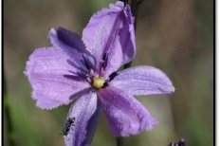
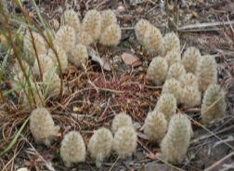
Ecosystem - Grasslands
Grasslands usually don’t have any trees ( sometimes there is one or two)
There are many different types of grasses, but also lots of wildflowers and orchids
Reptiles, mammals, birds and insects live in grasslands
In the summer, sometimes the soil cracks – this is a nice cool place for reptiles and insects to shelter from the hot sun.
Notes:
Image 1: Wallaby Grass
Image 2: Pink Bindweed
Image 3: Chocolate Lily
Image 4: Cracks in Soil
Image 5: Wallaby Grass dominated grassland on Taylors Creek
Image 6: Kangaroo Grass
Image 7: Blue Bells
Image 8: Spur Velleia
Image 9: Pussy Tails

Slide 14
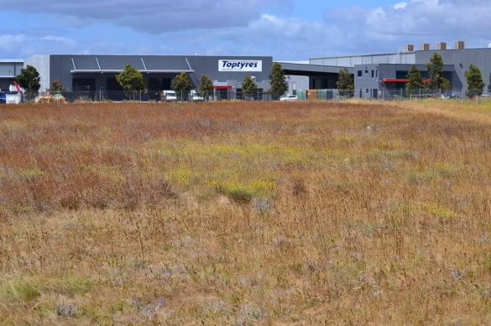
Ecosystems - Grasslands
Kangaroo Grass and Wallaby Grass
Grasses may not be as big as trees, but they are just as important – they provide food for mammals like Kangaroos and Wallabies as well as insects. They provide shade and shelter for lizards and snakes. They help bind the soil together to prevent erosion.
Can you imagine how dusty it would be in summer if there wasn’t any grass to protect the soil from the wind?
Notes:
Image 1: Wallaby Grass Seed Head
Image 2: Wallaby Grass dominated grassland on Taylors Creek
Image 2: Kangaroo Grass dominated grassland in St Albans
Image 3: Kangaroo Grass Seed Head
These grasses can be found in all ecosystems in Brimbank
The Wallaby is the only food source for the Golden Sun Moth

Slide 15
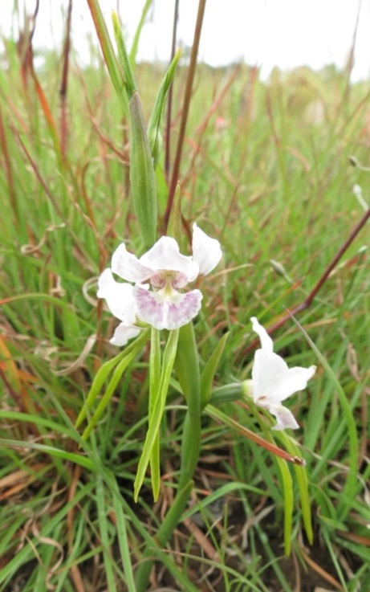
Ecosystems - Grasslands
Sunshine Orchid
This beautiful orchid was thought to be extinct until some plants were found in 2000.
There was once so many orchids in some areas of Maribyrnong that it was called “Snow in the Fields” because the white flowers looked like snow.
There is now only 30 known plants in the wild, but luckily Melbourne Zoo, the Royal Botanical Gardens and others are working hard to grow the orchid from seed and plant it in the wild.
Notes:
Legal Status
The Sunshine Diuris is listed as Endangered under the Australian Government Environment Protection and Biodiversity Conservation Act 1999 (EPBC Act), and Threatened under the Victorian Government Flora and Fauna Guarantee Act 1988. This means it is legally protected.
For more information http://www.dse.vic.gov.au/__data/assets/pdf_file/0009/103401/Sunshine_Diuris.pdf

Slide 16
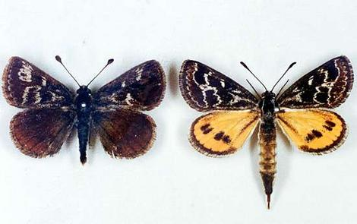
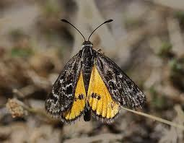
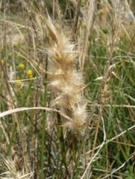
Ecosystem - Grasslands
Golden Sun Moth
This is a special animal found in Maribyrnong, it is Critically Endangered.
It only eats one type of grass – Wallaby Grass, only comes out in the sun and only lives for a few days as an adult (when it looks like a moth – not a caterpillar).
The adult doesn’t even eat – it doesn’t have a mouth!
Notes:
Legal Status The Golden Sun Moth is listed as Critically Endangered under the Australian Government Environment Protection and Biodiversity Conservation Act 1999 (EPBC Act). This means it is legally protected.
Image 1: Female on right, male on left
Image 2: Male in a grassland
Image 3: Wallaby Grass Seed Head

Slide 17
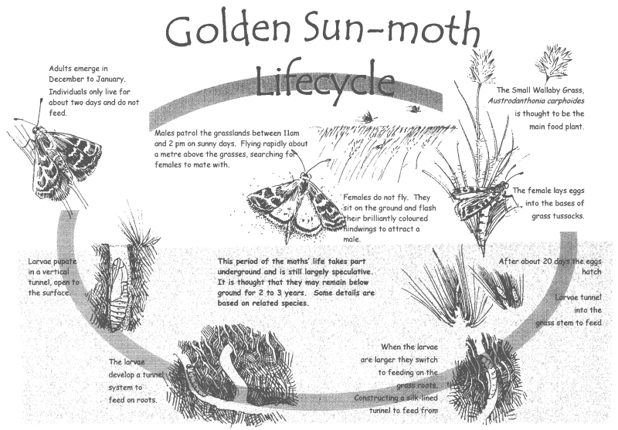
Ecosystem - Grasslands
Golden Sun Moth
Notes:
Image taken from Friends of Merri Creek Newsletter http://home.vicnet.net.au/~fomc/pages/golden-sun-moth.php

Slide 18
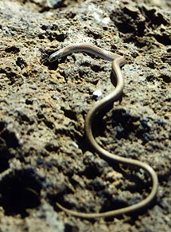
Ecosystem - Grasslands
Striped Legless Lizard
It’s not a snake – it’s a lizard!
It grows to 30cm long.
It has lost it’s legs through evolution, there are tiny little flaps on the body that shows it once had legs.
It has a round ended tongue like ours, not a forked tongue like a snake.
It lives in grasslands, but because there are not many grasslands left this lizard is very rare.
It squeaks when it is scared!
Notes:
VULNERABLE The Striped Legless Lizard is listed as vulnerable under the Federal Government’s Environment Protection and Biodiversity Conservation Act. This is a federal government act.
THREATENED
In Victoria, the striped legless lizard is considered threatened under the Flora and Fauna Guarantee Act. This is a state act.

Slide 19
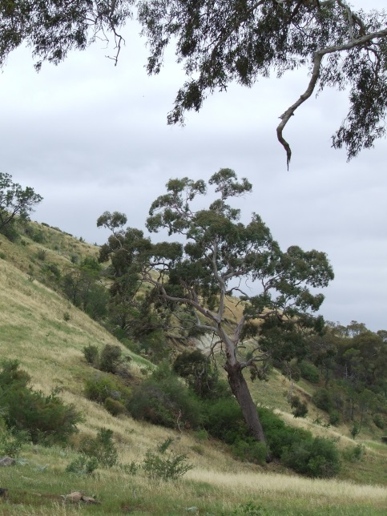
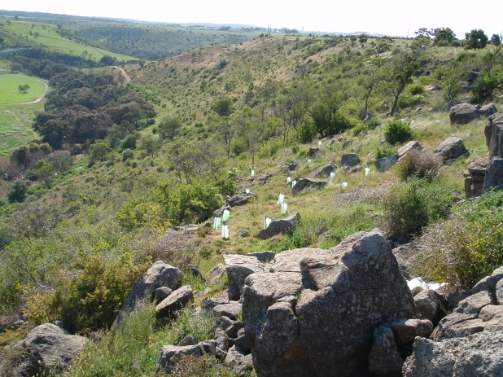
Ecosystem – Escarpment Shrublands
Escarpments are the steep slopes leading from the flat plains down into valleys. They sometimes have no trees or shrubs and sometimes have lots depending on how rocky it is, if it faces north and gets lots of sun, and how much water is available.
Notes:
Image 1: Escarpment at Sydenham Park off the Calder Freeway next door to Organ Pipes National Park. The escarpment leads down to Jacksons Creek which joins up with Deep Creek in this valley to form the Maribyrnong River. North facing (dryer and hotter than the south facing escarpments).
Image 2: Escarpment at Sydenham Park off the Calder Freeway next door to Organ Pipes National Park. The escarpment leads down to Jacksons Creek which joins up with Deep Creek in this valley to form the Maribyrnong River South Facing (cooler and damper than the north facing escarpments).
Image 3: Escarpment at Sydenham Park off the Calder Freeway next door to Organ Pipes National Park. The escarpment leads down to Jacksons Creek which joins up with Deep Creek in this valley to form the Maribyrnong River

Slide 20
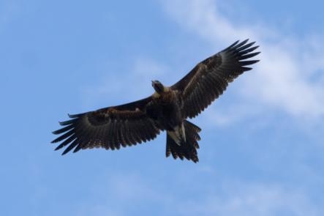
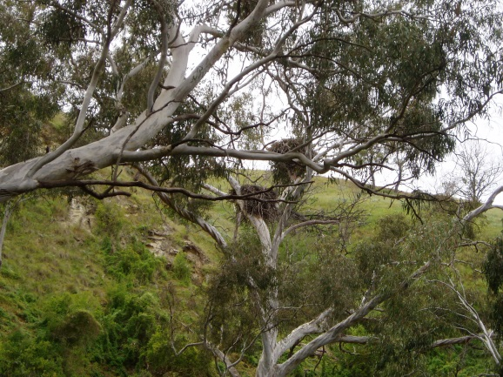
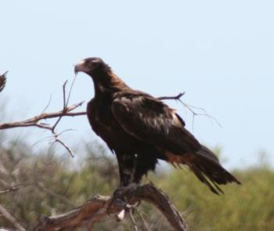
Ecosystem – Escarpment Shrublands
Wedge-tailed Eagle
You can often see these huge birds soaring on the wind currents that come off the escarpment. They can have a wingspan of 2m!
They make big nests in trees out of sticks and eat reptiles, birds and small mammals.
Notes:
Image 1: Soaring on the wind thermals
Image 2: Perched for a good view of prey
Image 3: Nest, showing large sticks used. Nests will be re-used every season. Just renovated a bit!

Slide 21
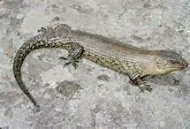
Ecosystem – Escarpment Shrublands
Cunningham’s Skink
A skink is a type of lizard. When skinks are scared or a predator wants to eat them, they can drop their tail off! The tail wriggles around and hopefully the animal that is trying to eat the skink, eats the tail instead of the animal!
The tails can grow back,
but usually not as big as
the first one.

Slide 22
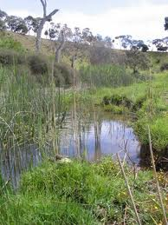
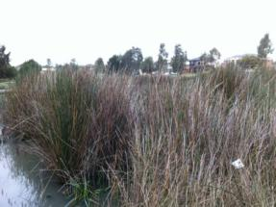
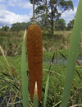
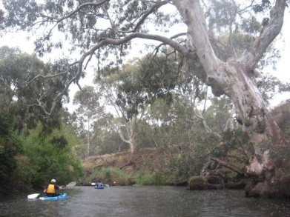
Ecosystem – Riparian (River) Flats
These are the areas around rivers, creeks and wetlands. The soil usually has lots of nutrients (food for plants) and there is water around so this is where you will find big trees, and lots of shrubs and grasses.
Around the edges of water you will find reeds which are grass like plants that grow near water.
Notes:
Image 1: Bull Rush – a type of reed
Image 2: Taylors Creek
Image 3: Maribyrnong River, Keilor
Image 4: Juncus – a type of reed. Sometimes it dies off in winter so it looks brown, but this is still a great for the ducks and frogs to live

Slide 23
Ecosystem – Riparian (River) Flats
In the water
You will find algae – which is like a type of plant. This is the green slimy stuff you see in the water. Too much algae is bad, but some is good. Tadpoles and Freshwater Snails love to eat it.
Notes:
Image 1: Freshwater Snail
Image 2: Algae on reeds
Sometimes if too many nutrients enter the water we can get an algal bloom, which is when the population of algae explodes. Algal Blooms are not good for waterways because it can block light from penetrating (important for other plants and animals living in the water). When the algae dies, it decomposes, this process uses up oxygen in the water which is also necessary for other plants and animals.
Nutrients can enter the waterways through detergents (phosphorus), and run off from gardens. (Many garden plants required added fertiliser).

Slide 24
Ecosystem – Riparian (River) Flats
Dragonfly
Dragonfly eggs are laid on reeds at the waters edge. The egg hatches into a Nymph which spends it’s life in the water . It hunts other small animals in the water. As it grows it sheds it’s outer skin. They move around by squirting water out their bottom!
The Nymph sheds it’s skin as it gets bigger, looking more and more like a dragonfly each time. On the last moult it crawls out of the water and emerges from it’s skin as an adult Dragonfly.
Notes:
Image 1: Dragonfly Nymph
Image 2: Dragonfly
Images from http://museumvictoria.com.au/discoverycentre/infosheets/dragonflies-and-damselflies/
The Nymphs usually live on the underside of pebbles and come out to hunt. Nymphs are different to the pupa of butterflies in that they do not form a cocoon. Instead they shed, and gradually change shape at each moult. The Nymph will crawl out of the water for it’s last shed and emerge as a dragonfly.

Slide 25
Ecosystem – Riparian (River) Flats
Tiger Snake
This snake usually has stripes across it’s body, but not always - sometimes it is just a dark brown colour.
It likes waterways and wet areas best as it’s favourite food is frogs, but it will also eat rats and mice, large insects and dead things.
It’s bite is very dangerous, so if you see one - stay away.
It thinks you are very dangerous, so if it sees you – it will stay away.
Notes:
Distribution and habitat
This species is common in some metropolitan areas of Melbourne, particularly the basalt plains of the western suburbs. It is widespread in Victoria although is absent from the non-riverine areas of the semi-arid north-west.
Biology and bite
Active both day and night, Mainland Tiger Snakes feed mainly on frogs, but also on a wide variety of other small vertebrates. Females usually give birth to 20–30 live young in late summer or early autumn.

Slide 26
Ecosystem – Riparian (River) Flats
Growling Grass Frog
The Growling Grass Frog can be brown, dull olive to bright emerald green on its back, with brown, golden, black or bronze spots or lines.
It is a big frog and can grow to 10cm long, and has been known to eat small snakes!
What do you think it sounds like?
Notes:
Legal Status The Growling Grass Frog is listed as Vulnerable under the Australian Government Environment Protection and Biodiversity Conservation Act 1999 (EPBC Act). This means it is legally protected.
The Growling Grass Frog is listed as Endangered under the Victorian Government Flora and Fauna Guarantee Act 1988.
Habitat
Growling Grass Frogs like to live amongst reeds, sedges and rushes growing in and along slow moving streams, ponds, lagoons, swamps, lakes and farm dams.
Food
Tadpoles eat algae and small water bugs.
Growling Grass Frogs eat beetles, termites, cockroaches, moths, butterflies and insect larvae. They can also eat lizards, snakes, fish and other frogs, including smaller members of their own species.
Behaviour
Males usually call while floating in open water. The call is several short grunts followed by a long deep growl that lasts for about one second – only the males call. Growling Grass Frogs breed in the spring and summer, usually from November to March. The females lay their eggs in a loose mass amongst floating vegetation. The tadpoles are pinky-grey with yellowy fins. They can reach 100mm before they metamorphose and turn into frogs.
The adult frogs are not active hunters; rather, they sit and wait for their prey to come to them. Growling Grass Frogs can move quite long distances (for a frog) to find suitable habitat – up to 700m
Predators: Other Growling Grass Frogs, birds, snakes, cats
Threats
Loss and fragmentation of suitable habitat is a continuous threat to Growling Grass Frogs. Polluted and unhealthy waterways are also a threat. Chytrid fungus, an infectious disease widespread in frog populations in eastern Australia, is also believed to be having a significant effect on Growling Grass Frog populations..

Slide 27
Ecosystem – Riparian (River) Flats
Kookaburra
The Laughing Kookaburra nests in open tree hollows, the babies are looked after by both parents, and will often stick around for a couple of years to help look after the next seasons babies.
They eat insects, mammals, frogs and even snakes (which they will kill by dropping from a height, or bashing against a tree)
Their laughing sound is not really meant to be friendly, they are telling all the other birds in the area to go away!
Can you make a Kookaburra sound?
Notes:
Habitat
The nest is a bare chamber in a naturally occurring tree hollow. Most tree hollows are found in Gum Trees, which won’t start developing hollows until they are 80 years old.
Food
They eat insects, mammals, frogs and even snakes (which they will kill by dropping from a height, or bashing against a tree) Both sexes share the incubation duties and both care for the young. Other Laughing Kookaburras, usually offspring of the previous one to two years, act as 'helpers' during the breeding season. Every bird in the group shares all parenting duties.
Behaviour
Laughing Kookaburras are believed to pair for life, both parents as well as other ‘helpers’ (often previous babies) look after the young . They breed from August to January. The chuckling voice that gives this species its name is a common and familiar sound and is often sung in a chorus with other individuals. The Laughing Kookaburra also has a shorter 'koooaa', which is normally given when accompanied by other members of its family group.
Predators
Eggs and young birds can be eaten by crows, snakes and rats. Older bids may be eaten by larger birds of prey like the Wedge-tailed Eagle.

Slide 28
Aboriginal History
Aboriginal people have been known to live on these plains and valleys for over 40,000 years.
The local aboriginal people are the Wurundjeri.
They trapped fish, hunted birds and Kangaroos and ate one of the most diverse plant diets in the world.
Fire was used as a tool to manage the land – as a way to minimise hot summer wildfires and as a method of harvesting plants and animals.
This land management has shaped what species are here today.
There are many signs here today of the long history of the Wurundjeri people in the local area.
Notes:
Image 1: Stone tool found along Taylors Creek
Image 2: Scar Tree where bark was removed for use as a carrying bowl.
Fire was used in cooler weather to reduce fuel loads and minimise the risk of summer wildfires.
It was also used to promote fresh growth which attracted kangaroos and wallabies. Fire opens up bare ground favouring food plant species such as the Murnong or Yam Daisy which was a staple food.

Slide 29
European Settlement
Early settlers selected the plains for grazing for the new exotic animals they introduced to Australia like sheep and cows.
They removed surface rocks were to make farming easier,
and ploughed the land to plant crops they had brought over
to Australia.
These introduced crop plants, and garden plants invaded the natural ecosystems, and became weeds which competed for space and water with the indigenous plants.
Introduced animals such as sheep, cows, cats, and dogs competed with or killed native animals.

Slide 30
European Settlement
Australia is riding on the sheep’s back.
Sheep grazing was a major industry in farming the local area of Maribyrnong.
The treeless grasslands of the Western plains provided a wealth of ready pastures to graze.
Notes:
Image 1:
Image 2:
Image 3:
Image 4:
Image 5:

Slide 31
Factories
Early 1900’s saw this region of Melbourne become the industrial hub of Melbourne large chemical complexes such as Monsanto were developed.
There was no Environment Protection Agency when all the chemical companies started, and there was a lot of pollution of both the creeks and the soil.

Slide 32
Other activities that have affected our Environment
Quarrying blue stone was one of the largest industries in this region, this left a series of quarry holes that were later used as tips.
Surface rocks are used for landscaping taking more habitat away.
Meat works along the Maribyrnong were typical of local industry that polluted the water ways – they once just used the river like a garbage disposal system….throw it in and it will be taken away!

Slide 33
Suburbs
How do we make a difference to our natural environment?
Garden plants escape (and then become weeds)
Rubbish dumping
Dog poo
Cats & Dogs
Vandalism
Notes:
Image 1:
Image 2:
Image 3:
Image 4:
Image 5:

Slide 34
Suburbs
How do we make a difference to our natural environment ?
Notes:
What can you do?
Join a Friends Group, help to clean up and plant up your local reserve or creek.
Form a Waterwatch monitoring group, and keep an eye the creek.
Dispose of garden waste on collection days or recycle in your own garden
Make sure that if you back on to any reserve that plants do not escape from you garden or that dog poo is not thrown over the fence.
Keep an eye on your local reserve and the creek if you see any problems report them to council.

