Slide 1
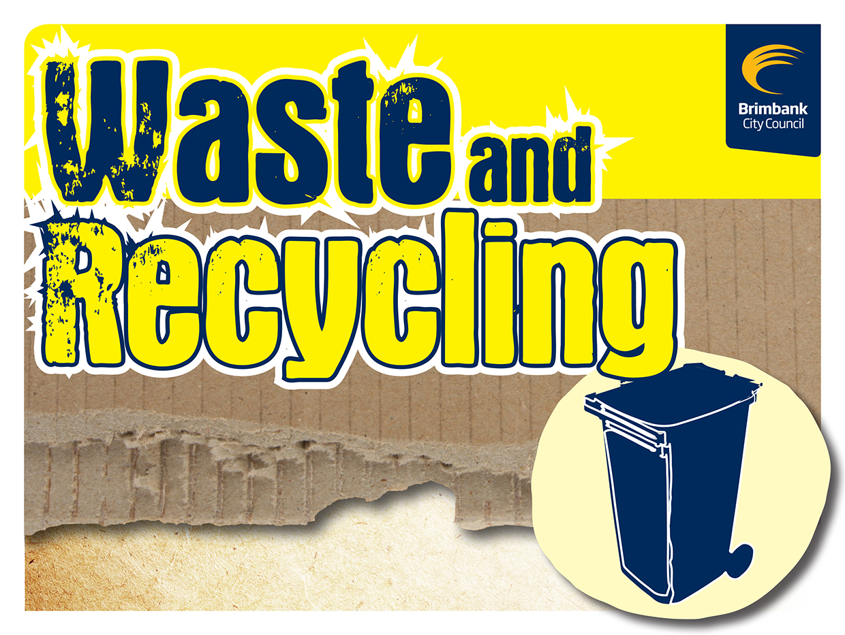
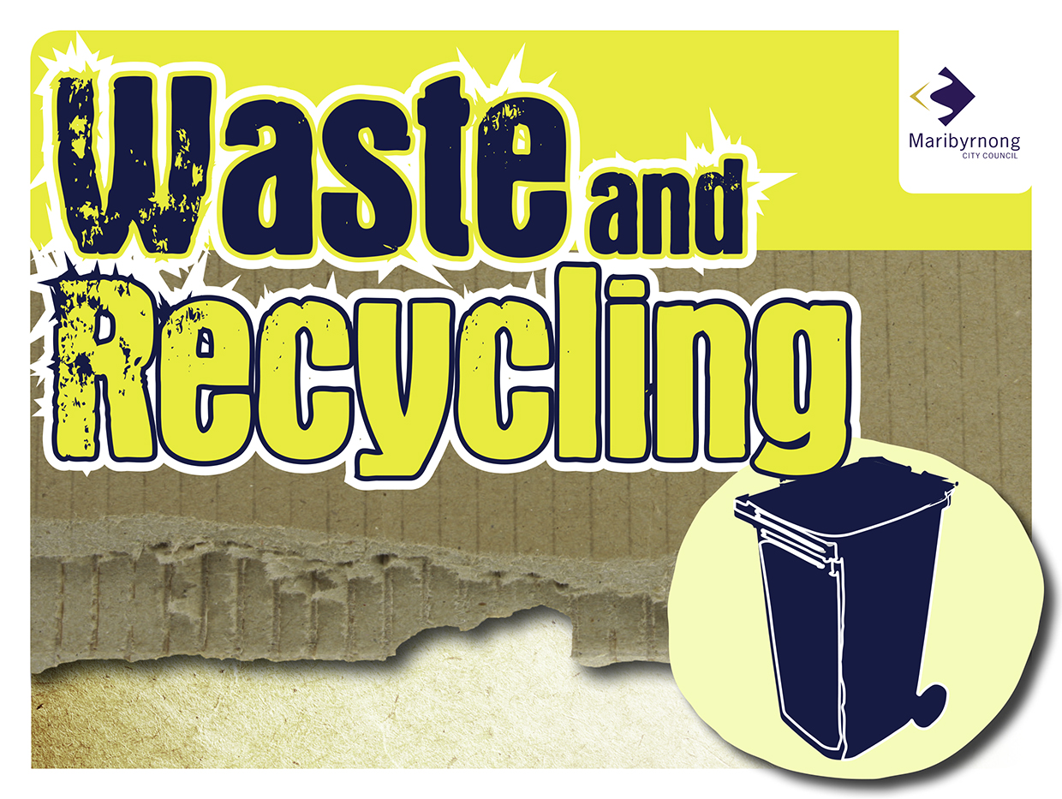

Slide 2
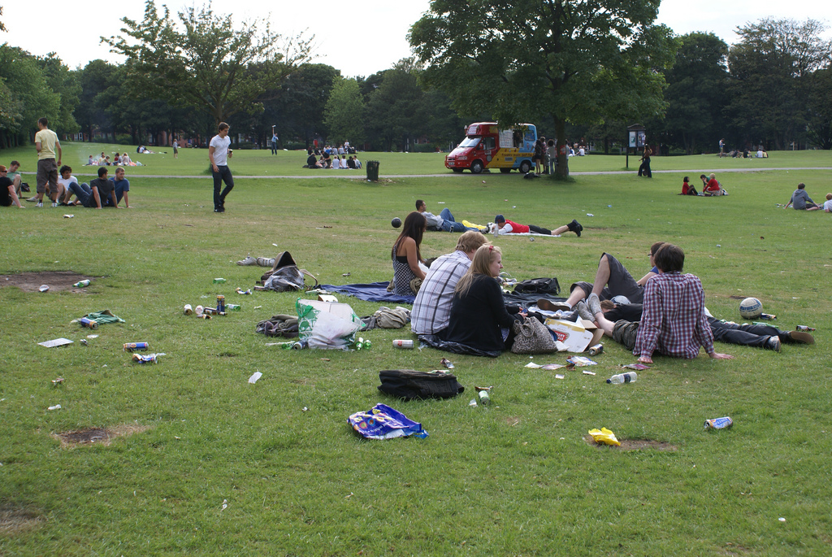
Where does our rubbish go?
Where does our rubbish go?
Imagine: You are at a picnic and you can’t find a bin. What do you do with your rubbish?
Do you leave it behind? Or do you take it with you?
Let’s look at what happens if you leave it behind.

Slide 3
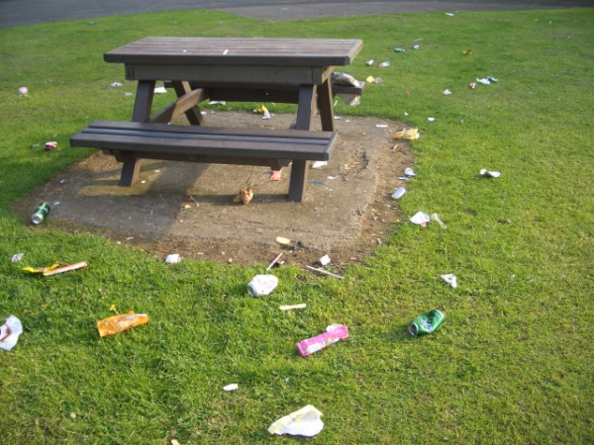
What happens when I litter?
What happens when I litter?
Rubbish that is not disposed of correctly is known as litter.
If you leave your rubbish in the park, it becomes litter.
This litter doesn’t just go away. It has to go somewhere. But where does it go?

Slide 4
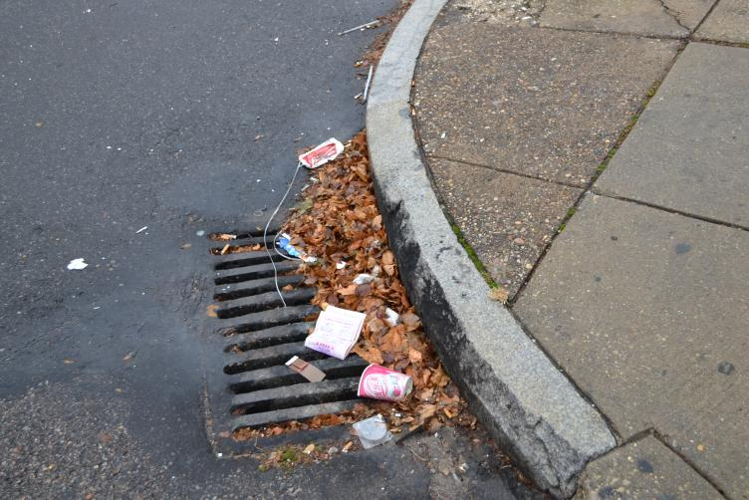
Litter in our waterways
Litter in our waterways
Some litter is washed into the gutter when it rains.
The drain grates stop some of the litter but most of it makes its way into the stormwater drain.
The water then makes its way into our waterways.

Slide 5
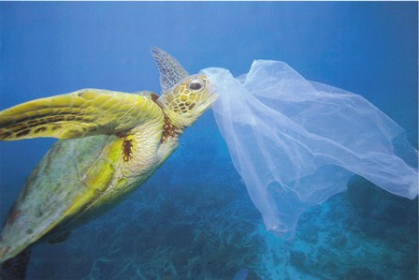
How litter affects our marine life
How litter affects marine life
Litter that leaves the drains doesn’t just end up in our local rivers and streams.
When the water from our rivers meets the ocean, the rubbish in the water enters the ocean as well.
Rubbish in the ocean is a major risk for marine life.

Slide 6
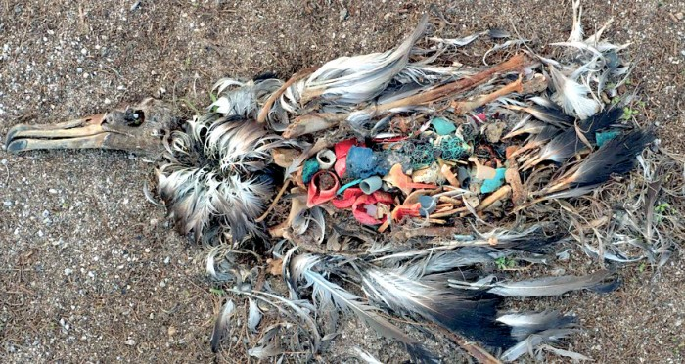
What does the litter do to marine life?
Birds are also at risk when litter reaches the ocean. As the litter breaks up into small pieces in the ocean, birds mistake it for food and swallow it.
Unable to digest the plastic, birds often die with stomachs full of our litter.
So what can we do?
Notes:
You could show a video of the ‘Great Pacific Rubbish Tip’ at this point to show the students how the plastics in the ocean become a kind of ‘soup’. This plastic soup is very difficult to remove from the ocean and therefore the best option is to reduce the amount of rubbish that enters the ocean in the first place.

Slide 7
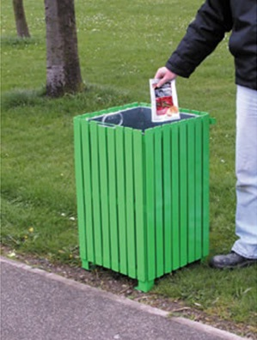
Putting rubbish in the bin
Instead of leaving your rubbish behind, where is the best place to put it?
The bin!
When you put rubbish in the bin it is no longer considered litter – as the bin is the correct place for the rubbish to go.
The bin is then emptied, just as your bin at home is emptied once a week. The rubbish is then taken away in a rubbish truck.
Notes:
Ask the students for examples of places they might produce litter at e.g. a park, playground, school.

Slide 8
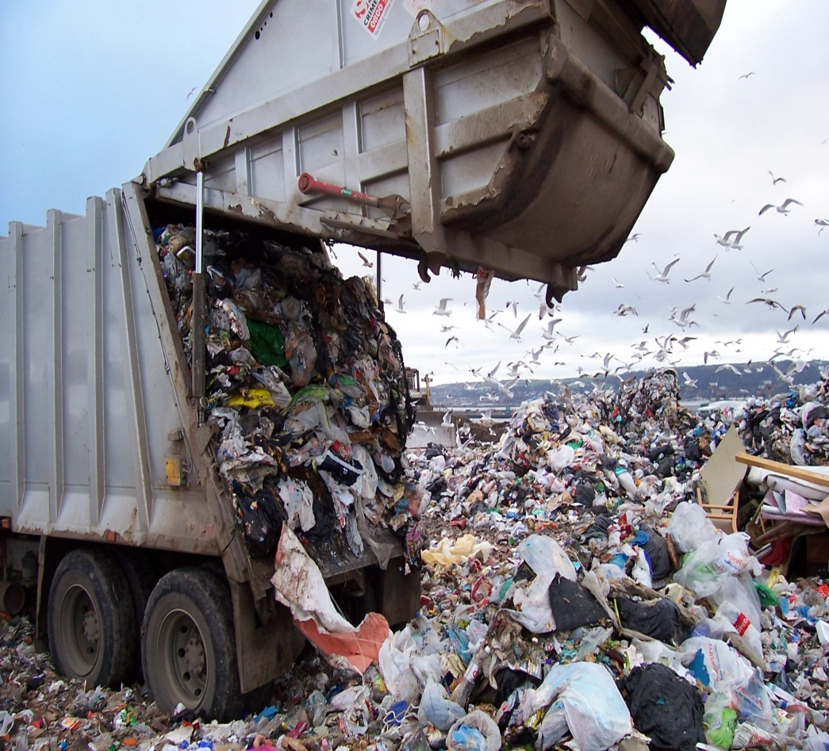
Where does our rubbish go?
The rubbish truck takes your rubbish to landfill - also known as the tip.
The rubbish is then put into piles and stored under the ground for a long time.
The more rubbish we send to landfill, the more space we need.
If we can reduce the amount of
rubbish we send to landfill, we will
need less landfills.
Notes:
Landfills are usually old quarries that have been converted into landfill. Once a landfill is full it is often turned into public land such as a golf course or public park. It is recommended that buildings are not built on top of landfills as methane will slowly seep out of the old landfills and change the shape of land – making it unsafe to build on.

Slide 9
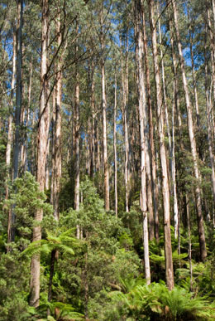
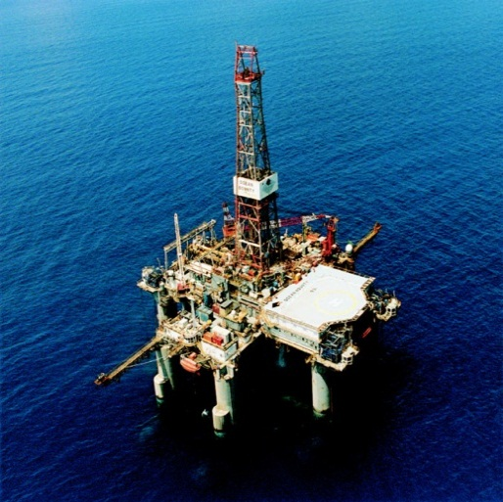
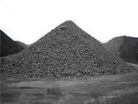
Recycling saves our natural resources
Another really important reason to recycle is to help save our natural resources.
All of the items we use every day need to be made out of something.
If we recycle and buy recycled items we will save:
Trees
Oil
Sand
Iron ore and
Bauxite (a mineral)
Notes:
We can save our natural environment by using recycled things instead of new materials
We can Save:
Trees: used to make paper
Sand: used to make glass
Oil: used to make plastic products
Iron Ore: used to make steel containers
Bauxite (aluminium ore): to make aluminium cans
Remember: when we put things in our recycling bin they get used again, in the garbage the resources are lost forever. Recycling means we are not only using these materials again but saving precious resources like: minerals, trees, oil, water, electricity, landfill space and reducing the amount of pollution and greenhouse gases we create.
Buying recycled items (such as recycled paper and toilet paper) is just as important as recycling your used paper. The more items we buy that are made from recycled content the less natural resources we will need to use.
You might like to talk to the students about the impacts of using all of our natural resources (such as deforestation, greenhouse gases etc.).

Slide 10
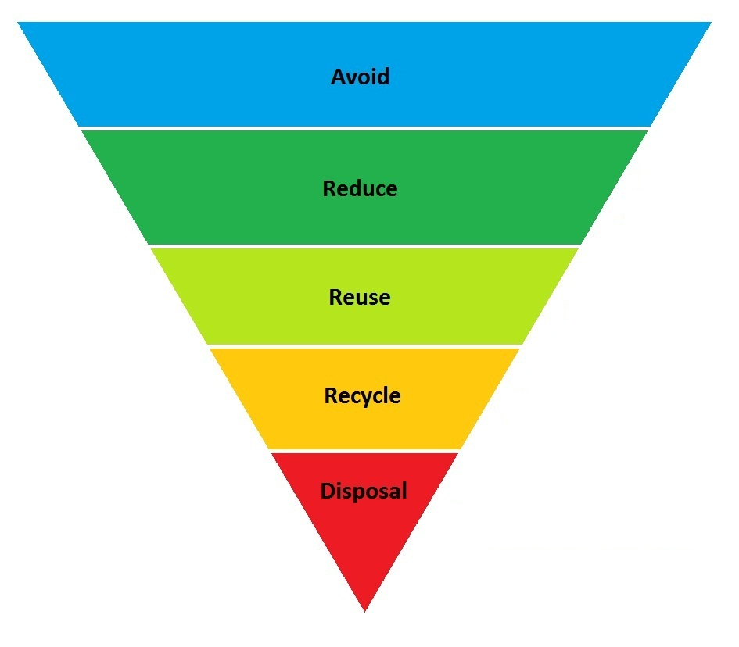
How can we help?
There are many ways to reduce the amount of natural resources that we use and avoid items going to landfill.
The best ways you can help is to:
Avoid
Reduce
Reuse and
Recycle
Notes:
Ask the students what they might be able to avoid, reduce, reuse and recycle before going through the following examples with them.
Avoid: buying more food than you will eat; plastic bags by bringing your own bag; buying single use plastic water bottles.
Reduce: fix old items before purchasing new ones; buy items with less or no packaging; reduce food waste by composting.
Reuse: use both sides of paper before recycling; use a reusable water bottle and lunchbox; swap clothes and toys with friends.
Recycle: recycle paper, cardboard, glass, plastic bottles and containers, and aluminium and steel cans.

Slide 11
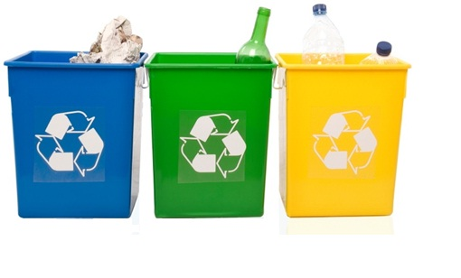
Recycling
The first one of these topics we will look at is recycling.
There is a lot of packaging which can be recycled instead of being thrown in the bin and sent to landfill.
The more you recycle, the less you will need to throw away.
What can and can’t be recycled?
Notes:
Ask the students to list as many recyclable items as they can. You could break these into items that can be recycled in our recycling bins at home (paper and cardboard, plastic bottles and containers, glass bottles and jars and steel and aluminium cans) and items that can be recycled elsewhere (mobile phones, batteries, clothes etc.).

Slide 12
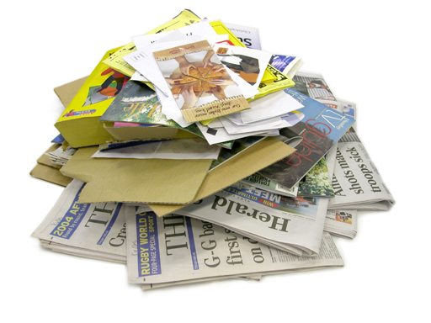
Recycling paper
We use paper every day. Once we have finished using paper we can put it into the recycling bin.
What paper can be recycled?
School paper
Magazines and newspapers
Letters and Envelopes (with windows left in)
Junk mail and
Phone books
Notes:
Reinforce answers by going over the slides. Ask the students for examples of what paper and cardboard items can be recycled?

Slide 13
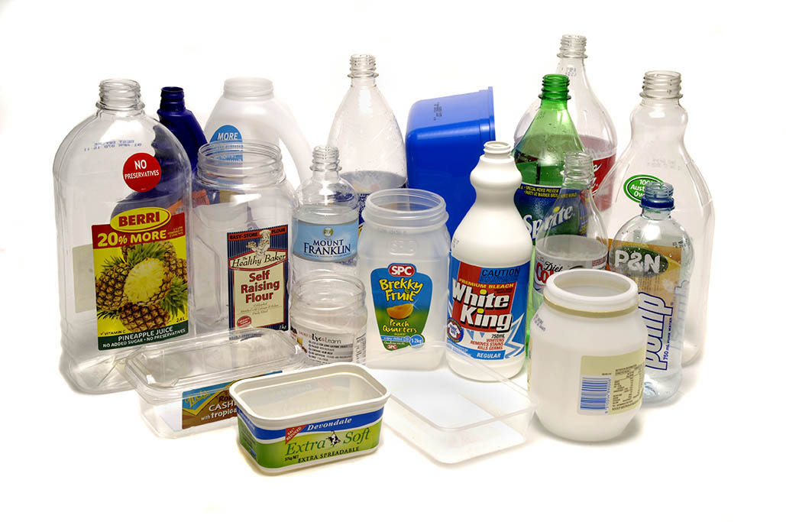
Recycling plastic
Plastic is used to make all sorts of bottles and containers. If we don’t reuse the containers we can recycle them.
What plastics can be recycled?
Water, soft drink and juice bottles
Yoghurt and margarine containers
Take-away containers
Shampoo bottles and
Detergent bottles
Notes:
Ask the students for examples of what hard plastic items can be recycled?
There are plenty of ways you can reuse plastic containers at home and at school. We will touch on this idea a little later on in the PowerPoint.

Slide 14
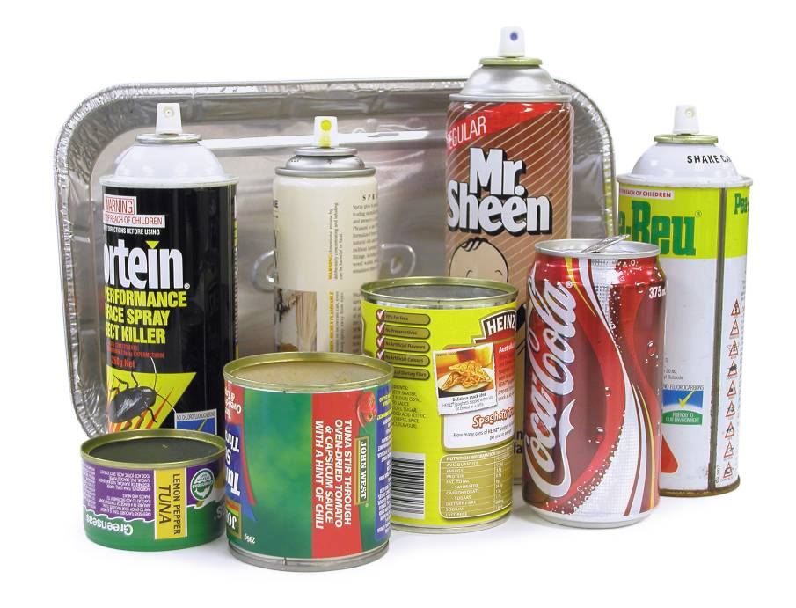
Recycling aluminium and steel
Aluminium is one of the most important materials to recycle.
What aluminium and steel items can be recycled?
Aluminium cans (drink cans)
Steel cans (food cans)
Aerosol cans
Aluminium foil
Pie trays
Notes:
Ask the students for examples of what metal items can be recycled?
Aluminium is one of the most important materials to recycle. As aluminium doesn’t reduce in quality when it is recycled, it can be used over and over again and still be a very high quality. This is different to plastic which reduces in quality every time it is recycled.
For every aluminium can you recycle you are saving enough energy to power a TV for three hours! If you don’t recycle the aluminium can, the mineral bauxite needs to be mined to produce another can (which is very energy intensive).

Slide 15
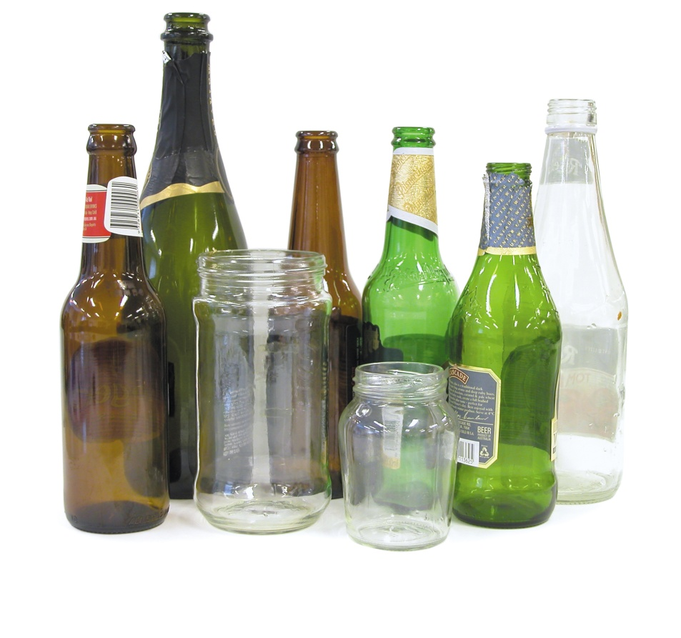
Recycling glass
Glass is used to provide strong and see-through storage for a lot of the items we eat and drink.
There are two glass items that we can put into the recycling bin. They are:
Glass Bottles and
Glass Jars
Notes:
Ask the students for examples of what glass items can be recycled?
Glass comes in three different colours: brown, green and clear. Some manufacturers add colour to the clear glass to make it into new colours such as blue or pink.
It is important to only recycle glass bottles and jars in the regular recycling bin. The reason we are unable to recycle glass items such as Pyrex bowls and glass vases in the regular recycling is that they melt at a higher temperature and therefore would not melt down in the same way as the glass bottles and jars. This would cause a lot of problems at the glass recyclers and therefore it is important to make sure we only put glass bottles and jars in the recycling.
You can always reuse/donate old glass vases and Pyrex bowls to friends and family once you no longer want them.

Slide 16
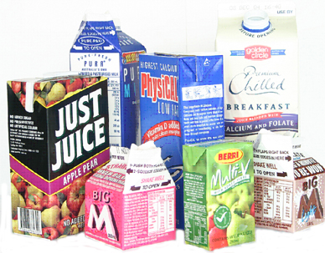
Recycling cardboard
The final thing we can put into our recycling bin is cardboard.
What cardboard items can be recycled?
Cardboard boxes
Milk cartons and juice containers
Pizza boxes (without food scraps)
Cardboard folders
Notes:
Ask the students for examples of what types of cartons can be recycled?
Any containers that once contained food do not need to be washed before you recycle them. Simply scrape out as much of the food as you can and put them into the recycling bin. At the recycle centre the items will be washed before being recycled.

Slide 17
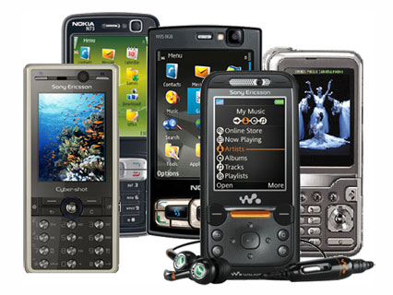
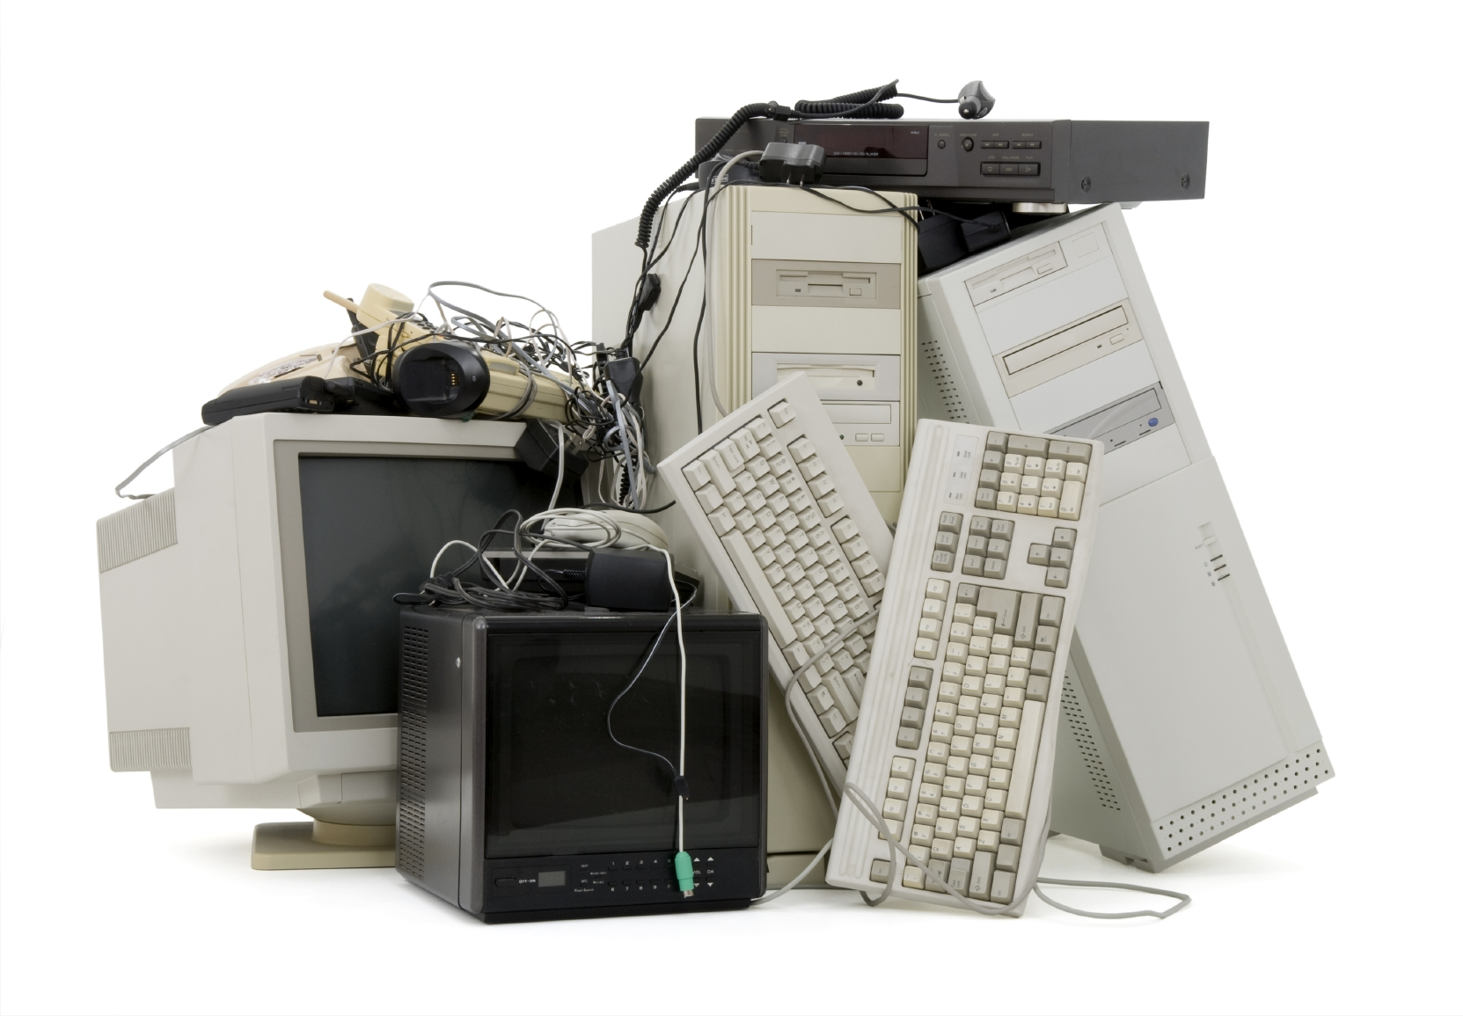
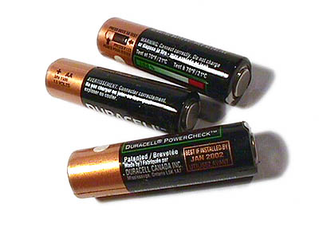
What else can be recycled?
Old mobile phones
Old batteries
Old electronics (E-Waste)
Notes:
There are things that cannot go into your home/school recycling bin but we can still recycle them. Examples of these are on the slide.
The Planet Ark website has great recycling facts on these items. http://planetark.org/
Mobile phones – Recycle at Melbourne Zoo. It is really important to recycle your old mobile phones. Mobile phones are made of plastics and metals such as aluminium and coltan. The coltan in mobile phones is mined in areas of the Congo in Africa which is habitat for gorillas. Find out more at: http://www.zoo.org.au/get-involved/act-for-wildlife/theyre-calling-on-you
Batteries – http://recyclingnearyou.com.au/batteries/
E-Waste – anything with an electrical cord is considered ‘e-waste’. It is important to keep e-waste out of landfill as we can recycle a lot of the plastics used in electronics to make new electronics.

Slide 18
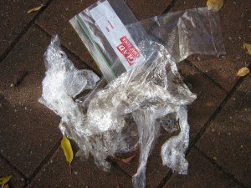
What about recycling soft plastics?
Soft plastics need to be recycled in a special way.
Soft plastics are items such as:
Plastic bags
Glad wrap
Plastic chip packets and
Pasta and rice packets
These can all be recycled at selected supermarkets and turned into
recycled furniture for your school!
Notes:
Soft plastics such as glad wrap and biscuit trays cannot be recycled using the regular recycling bin as they melt at different temperatures to hard plastics such as plastic bottles. Instead of throwing these soft plastics away, you can collect them and once you have a full bag full you can drop them off to a COLES supermarket ‘Red Group’ bin where the soft plastics will be recycled and turned into recycled furniture for schools.
This is a great way to keep soft plastics such as plastic bags out of landfill.
This is a program called the RED Project run by the Red Group. To learn more about the RED Project visit the web site: www.redproject.net.au
Ask the students why else we should recycle before talking about saving our natural resources (next slide).

Slide 19
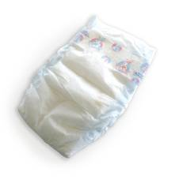
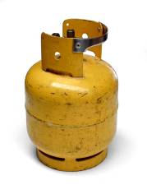
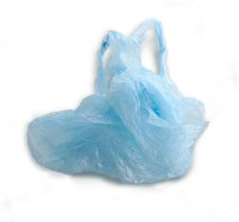
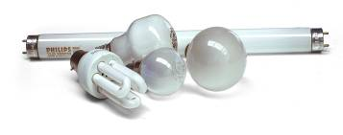
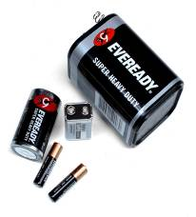
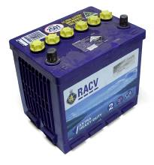
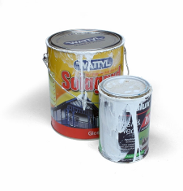
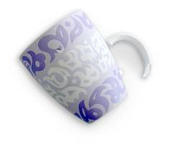
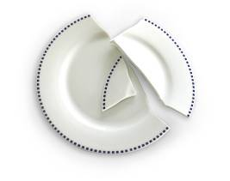
What can’t be recycled at home?
There are some things that should never be put in the recycling bin at home:
Gas Cylinder
Nappies
Polystyrene
Plastic bags
Light bulbs
Ceramic Plates & Cups
Drinking Glasses
Household &
Car Batteries
Paint Cans
Notes:
Discuss what shouldn’t be placed in the recycle bin, list the examples on the slide, emphasise the plastic bags.
It is important that you do not place your non recyclable items in your recycling bin. These non-recyclables are called contaminants, common contaminants are plastic bags, polystyrene, food, garden waste and nappies. If there is a high percentage of contamination in the truck load then chances are the whole load will be rejected and sent to landfill. Machinery can be forced to shut down if contaminants (e.g. clothing) enter the machine. Health and safety is also a concern for sorters as they could be injured (e.g. by handling a needle).

Slide 20
Where does our recycling go?
Now that you know what can an cannot be put in the recycling bin the big question is – where does our recycling go?
Big Questions:
Why should we recycle?
What are plastic bottles recycled into?
What are aluminium cans recycled into?
A Recycling Journey
Notes:
If you would like a copy of the ‘Recycling Journey’ please contact the Environmental Education Officers on 03 9249 4000 and we will happily send you one.
Before you watch the journey ask the students to watch out for the questions listed above. At the end of the 12min DVD discuss the answers. The link to the DVD is found on the follow up activities sheet.
Plastic bottles are recycled into new plastic bottles, carpet, clothing, furniture, compost and recycling and garbage bins and agricultural pipe.
Aluminium cans are recycled into new aluminium cans and car parts.
OR – the information is detailed in the following slides about the Material Recovery Facility (MRF)

Slide 21
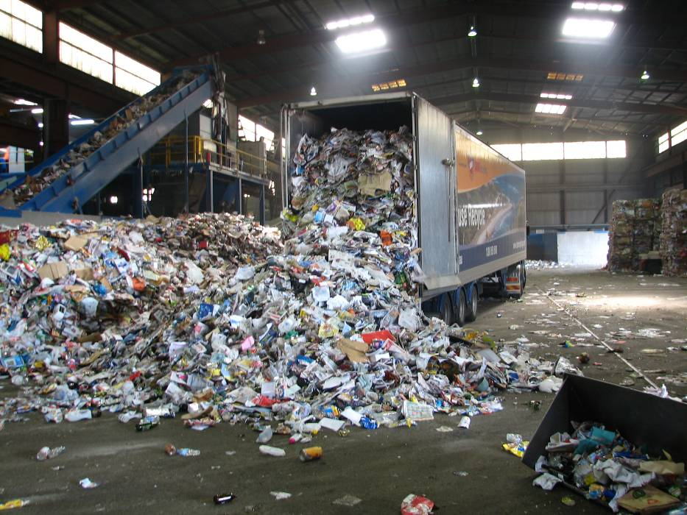
Where does our recycling go?
Recycling trucks collect our recycling once a fortnight.
Once the truck is full it delivers your recycling to a Material Recovery Facility (MRF).

Slide 22
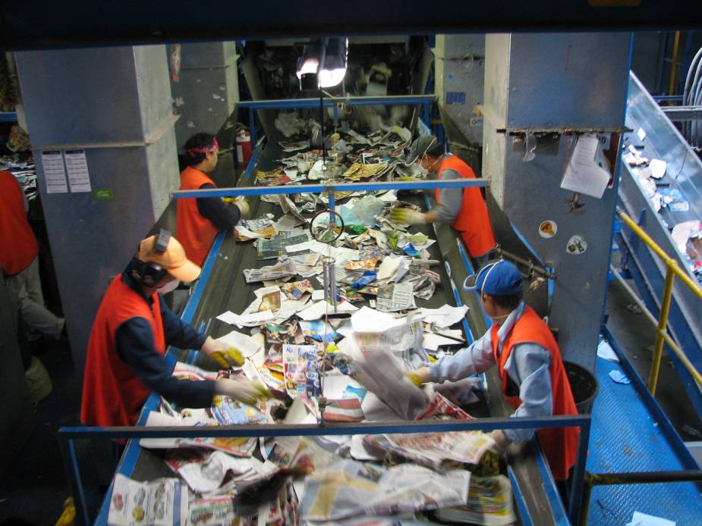
At the Material Recovery Facility
All of the items which have been collected by the recycling truck are then poured onto a conveyer belt.
Here workers take out anything that is non-recyclable by hand.
This is a very difficult job and becomes even harder if people put the wrong things into the recycling.
Notes:
It is important to try to not put non-recyclable items in the recycling bin as this removal process can be dangerous for the workers.

Slide 23
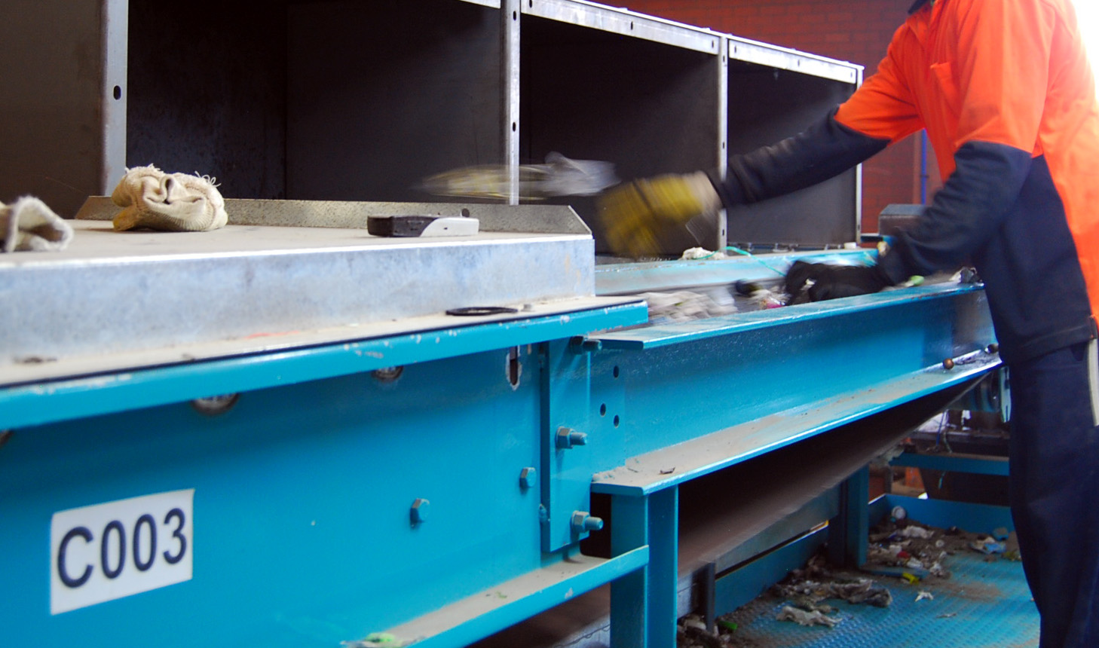
At the Material Recovery Facility
Items are then separated into their material type.
The first materials to be separated out are paper and cardboard.
Paper and cardboard are sorted using a vibrating disc screen (a conveyor belt that bounces up and down).
Notes:
The vibrating disc screen is a conveyor belt that bounces up and down. As it bounces the light items (like paper and cardboard) float to the top while the heavy items (such a plastic, metal and glass) sink to the bottom. This allows the paper to be ‘scraped’ off the top of the pile.

Slide 24
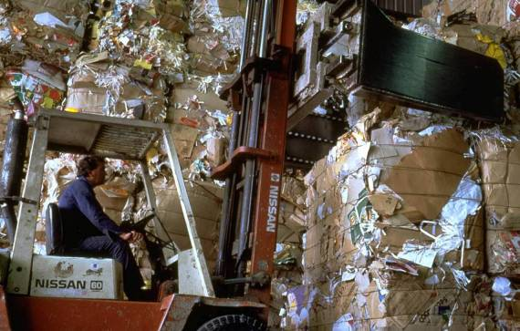
At the Material Recovery Facility
Once the cardboard and paper are separated and baled they are ready to be taken to paper mills.

Slide 25
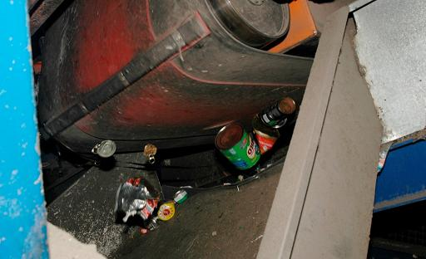
At the Material Recovery Facility
Magnets are used to separate out the steel.

Slide 26
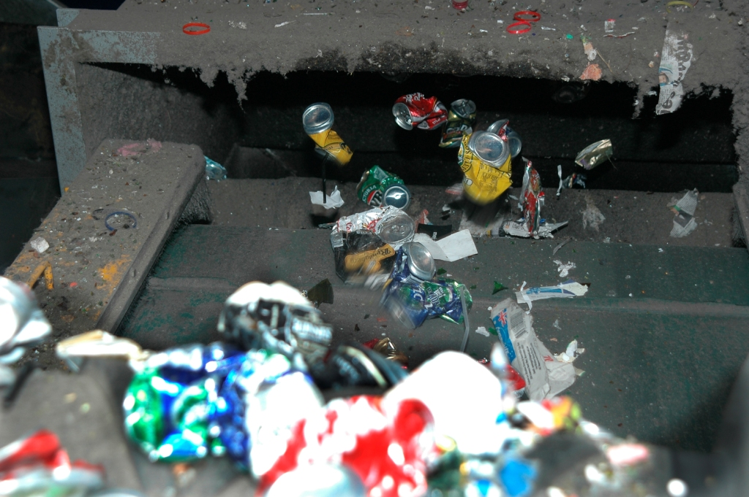
At the Material Recovery Facility
Aluminium cans are removed using an eddy current which pushes the cans into a separate area to the other materials.
Notes:
The eddy current is similar to a reversed magnet – its pushes metal items away from it rather than pulling them towards it like a magnet would. This allows the aluminium items to jump over a barrier and be captured in a separate container. This aluminium is then ready to be processed into new items

Slide 27
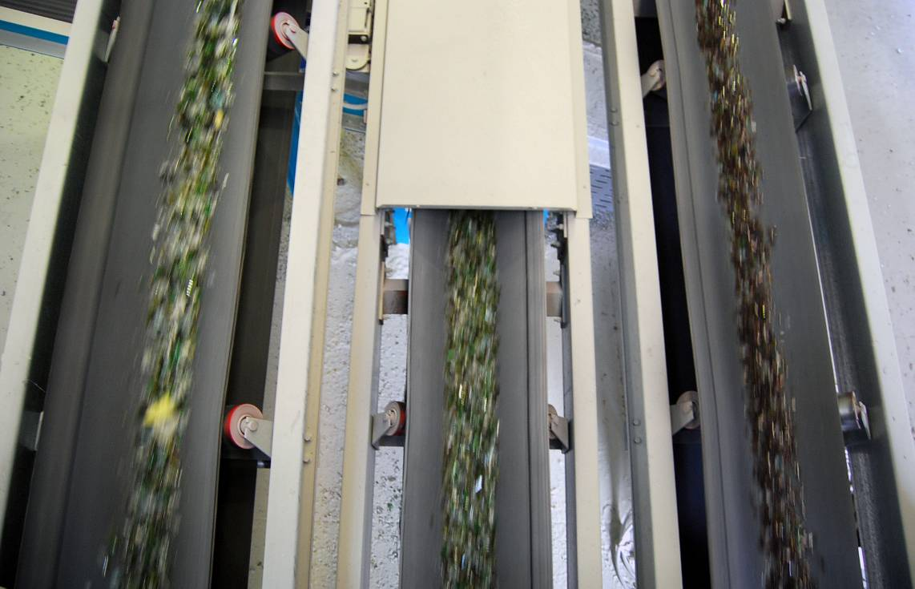
At the Material Recovery Facility
Finally, lasers are used. To sort the glass material by colour.
These materials are then sent off to be turned into new items.
What do you think can these materials be turned into?
Notes:
Glass is the last item left in the sorting process because it is the heaviest. Once all the other items are removed the glass is sorted by colour (clear, green and brown). This colour sorting means it is easier to make the glass into new products as they don’t have to be re-coloured.

Slide 28
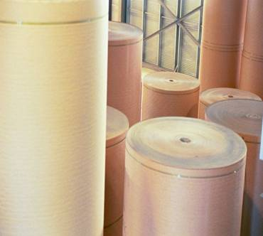
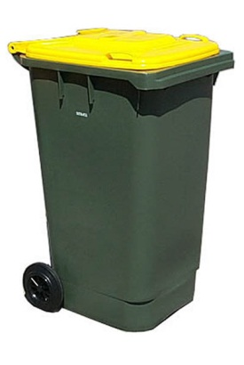
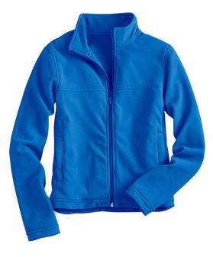
Recycled items are turned into new things
Paper
Plastic
Notes:
Once the items have been separated at the Material Recovery Facility they are sent to manufacturers to be made into new things.
Paper items like newspapers and phone books are recycled into new rolls of paper that can be used again.
Our hard plastic products like empty detergent bottles and soft drink bottles are turned into new bottles, wheelie bins and can even be turned into clothing!
Glass bottles are turned into new glass bottles, and aluminium and steel cans are recycled into new cans.
Ask: What other things can the students list that could be made out of recycled materials?

Slide 29
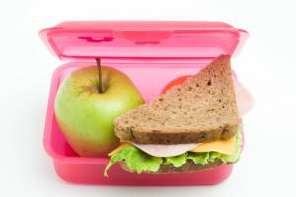
Reuse
What is even better than recycling a container every time you use it?
Reusing it!
Think about your lunch box and your water bottle. You reuse them every day.
Imagine if you recycled your lunch box every day!
Notes:
Reusing items is even better than recycling. As recycling is a very energy and water intensive process, it is far better to reuse an item than to recycle it and buy another one.
There are many ways to reuse your items. Reusing your lunchbox and water bottle every day is much better than bringing your food in glad wrap and purchasing a plastic bottle. This can be a great activity: ask the students to come up with as many ways as possible to reuse a tin can, or a plastic bottle. There are always useful things that you can use old jars and egg cartons for around the classroom as well.

Slide 30
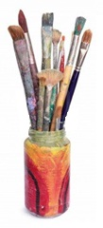
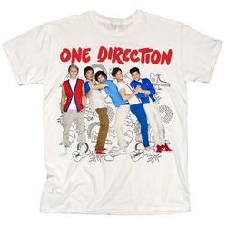
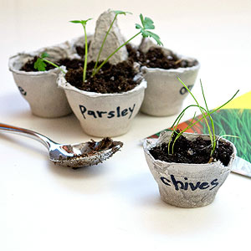
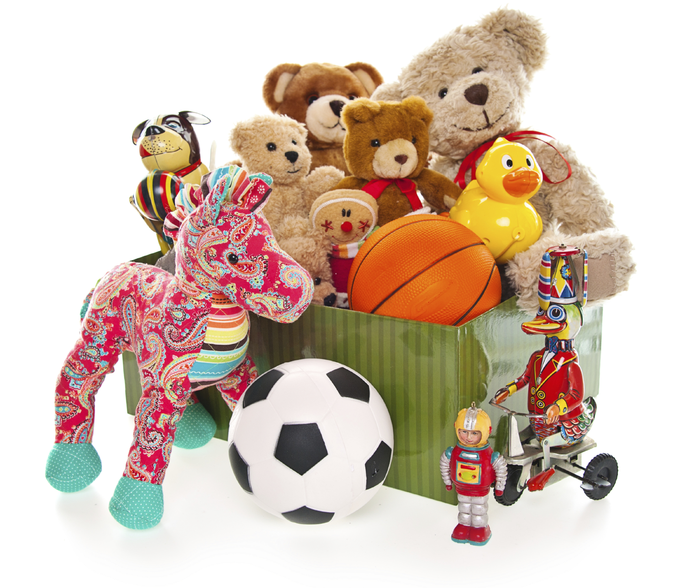
What else can be reused?
You can reuse an item yourself, or give it away to be reused by someone else!
Notes:
By taking your old toys, clothes and books to an opportunity shop they will have the opportunity to be reused by someone else – keeping them out of landfill!

Slide 31
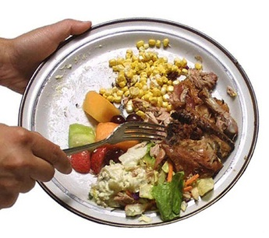
Reduce
What is even better than reusing and recycling?
Reducing!
The biggest and easiest thing we can reduce is food waste. Almost half of our weekly waste is food waste.
If we make sure we only buy what we need to eat and don’t throw left over food away we will reduce a lot!
Notes:
Ask the students: What can we do with food waste if we don’t want to put it in the rubbish bin?
For more information on food waste visit: www.foodwise.com.au

Slide 32
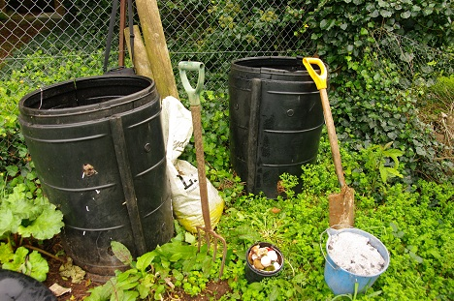
Composting and worm farms
There is another great way to reduce food waste:
Composting and worm farms!
Composting is another form of recycling. You can compost:
Fruit and vegetable scraps
Paper and cardboard
Garden scraps and more!
Notes:
Composting is nature’s way of recycling garden waste, including grass cuttings, twigs and leaves. The garden waste breaks down on a compost heap to make a rich, crumbly soil which can be used to help plants grow.
Ask the students what can and cannot be placed in the compost bin?
Answer: can be placed in the compost bin: fruit and veg scraps, garden waste (small twigs, grass, dead leaves and sticks), paper and cardboard/egg cartons, vacuum dust, hair, egg shells, tea and coffee, citrus, onions, and garlic.
Can’t be placed in the compost bin: plastic items (plastic bag takes 1000 years to break down), metal items, dog or cat poo, diseased plants or weeds, dairy foods, oils, meat, bones, fat, oily foods and bread.
Another form of composting is worm farming. Worms farms are a little different from compost bins, for example they need a little bit more attention and are a bit more limiting in what you can feed them. Worm farms can only take food waste (except for citrus, onions, garlic, dairy foods, meat, bones, fat, oily foods and bread).
Worms eat our fruit scraps and rotten vegetables and turn it into rich soil castings and liquid worm tea that can be used to fertilise plants.
In worm farms, worms eat our food scraps and turn them into great soil and fertilisers for the garden.
Remember, worms are great pets so you need to remember to take care of them!

Slide 33
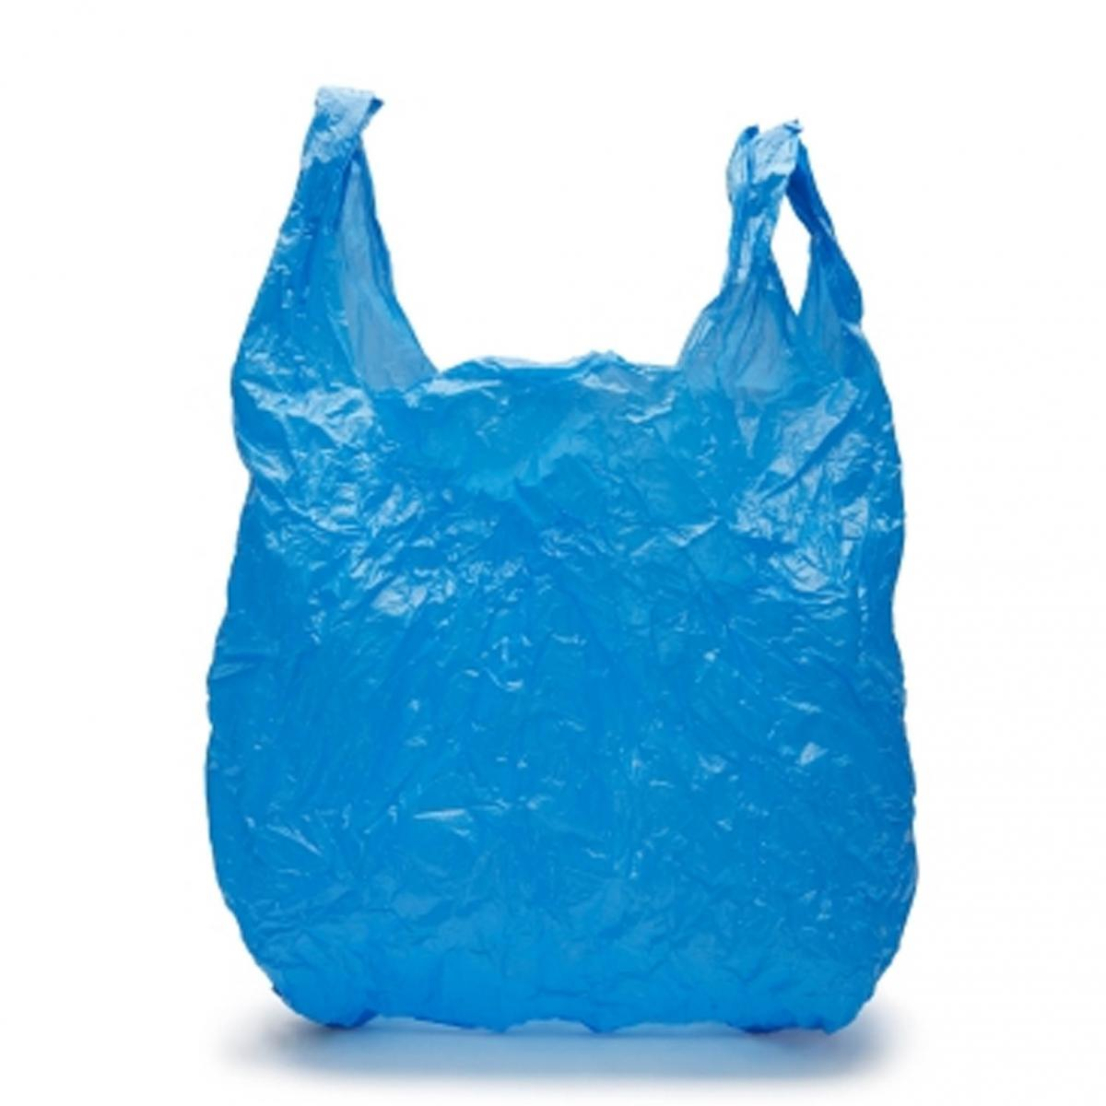
Avoid
What is the best way to reduce waste going to landfill?
Avoiding!
There are a lot of things you can avoid to help reduce waste.
Can you name something that you could avoid buying or using which will help to reduce waste?
Notes:
Examples include; single-use bottles, plastic bags and individually wrapped items. Ask the students to list other examples they can think of.

Slide 34
Next steps
Everyone can help to reduce waste, just remember the four steps:
Avoid
Reduce
Reuse and
Recycle
Now let’s do an activity about
reducing our waste!

